Slide 1

The Business Problem
ABC company wants to develop a targeted marketing strategy to increase their customer base by 20% by the end of 2021, by studying customer coupon redemption from precious campaigns
Notes:
Hypothesis: Create a Hypothesis with an emphasis on SMART principles. (S – Specific, M – Measurable, A – Achievable, R – Realistic, T – Timebound). If you cannot do this, you do not have a good grasp on the business problem.
Context: With context, we have clearly identified the problem at hand and have elucidated on how our initiative may solve this problem, alongside the commercial implications this will have on the business.
Criteria for Success: Clearly defining the criteria for success ensures that the scope of your work is clearly defined and understood. Otherwise, if this isn’t defined – your work will never end which will result in mismatched expectations.
Scope of Solution Space: Scoping out the solution space ensures that the business initiative is SPECIFIC for a certain segment or area. This prevents solutions that have been developed being scaled and applied for all other business units that the solution may not be responsible or scalable for.
Constraints within Solution Space: Looking forward, what are the foreseeable problems we are likely to encounter? Could this be stakeholder resistance? Could this be we don’t have access to the right data?
Stakeholders to provide key insight: Who are the people I need to speak to, to get the answers I need for my data analysis?
What key data sources are required?
Based off my discussions with the key stakeholders – can we clearly list out all the data sources we need so we can make a highly targeted request as opposed to a scatter-gun approach where we ask for a bit of everything?

Slide 2
Context
Brick-and-mortar retailer
Marketing campaigns for new and existing customers
Machine learning for predicting coupon redemption
Improving marketing strategy
Increasing coupon redemption
Larger customer base
Notes:
Hypothesis: Create a Hypothesis with an emphasis on SMART principles. (S – Specific, M – Measurable, A – Achievable, R – Realistic, T – Timebound). If you cannot do this, you do not have a good grasp on the business problem.
Context: With context, we have clearly identified the problem at hand and have elucidated on how our initiative may solve this problem, alongside the commercial implications this will have on the business.
Criteria for Success: Clearly defining the criteria for success ensures that the scope of your work is clearly defined and understood. Otherwise, if this isn’t defined – your work will never end which will result in mismatched expectations.
Scope of Solution Space: Scoping out the solution space ensures that the business initiative is SPECIFIC for a certain segment or area. This prevents solutions that have been developed being scaled and applied for all other business units that the solution may not be responsible or scalable for.
Constraints within Solution Space: Looking forward, what are the foreseeable problems we are likely to encounter? Could this be stakeholder resistance? Could this be we don’t have access to the right data?
Stakeholders to provide key insight: Who are the people I need to speak to, to get the answers I need for my data analysis?
What key data sources are required?
Based off my discussions with the key stakeholders – can we clearly list out all the data sources we need so we can make a highly targeted request as opposed to a scatter-gun approach where we ask for a bit of everything?

Slide 3
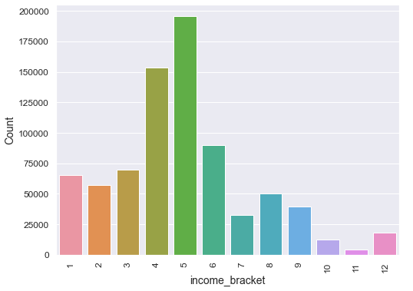
Data Analysis
Most customers belong to middle income range
Notes:
Hypothesis: Create a Hypothesis with an emphasis on SMART principles. (S – Specific, M – Measurable, A – Achievable, R – Realistic, T – Timebound). If you cannot do this, you do not have a good grasp on the business problem.
Context: With context, we have clearly identified the problem at hand and have elucidated on how our initiative may solve this problem, alongside the commercial implications this will have on the business.
Criteria for Success: Clearly defining the criteria for success ensures that the scope of your work is clearly defined and understood. Otherwise, if this isn’t defined – your work will never end which will result in mismatched expectations.
Scope of Solution Space: Scoping out the solution space ensures that the business initiative is SPECIFIC for a certain segment or area. This prevents solutions that have been developed being scaled and applied for all other business units that the solution may not be responsible or scalable for.
Constraints within Solution Space: Looking forward, what are the foreseeable problems we are likely to encounter? Could this be stakeholder resistance? Could this be we don’t have access to the right data?
Stakeholders to provide key insight: Who are the people I need to speak to, to get the answers I need for my data analysis?
What key data sources are required?
Based off my discussions with the key stakeholders – can we clearly list out all the data sources we need so we can make a highly targeted request as opposed to a scatter-gun approach where we ask for a bit of everything?

Slide 4
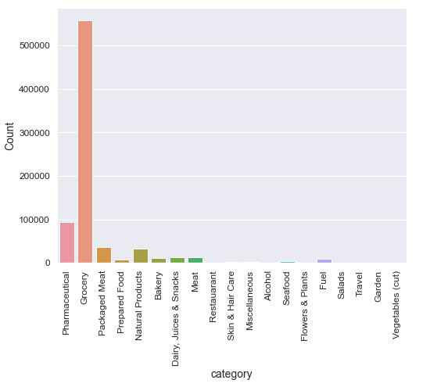
Data Analysis
A vast majority of sales fell under Grocery category

Slide 5
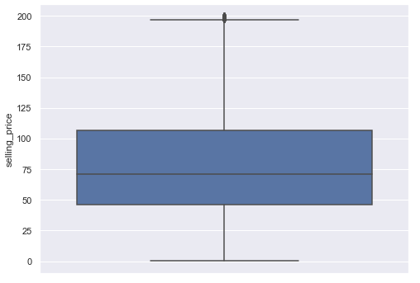
Data Analysis
Selling price in half the transactions falls roughly between $45 and $110
Notes:
Hypothesis: Create a Hypothesis with an emphasis on SMART principles. (S – Specific, M – Measurable, A – Achievable, R – Realistic, T – Timebound). If you cannot do this, you do not have a good grasp on the business problem.
Context: With context, we have clearly identified the problem at hand and have elucidated on how our initiative may solve this problem, alongside the commercial implications this will have on the business.
Criteria for Success: Clearly defining the criteria for success ensures that the scope of your work is clearly defined and understood. Otherwise, if this isn’t defined – your work will never end which will result in mismatched expectations.
Scope of Solution Space: Scoping out the solution space ensures that the business initiative is SPECIFIC for a certain segment or area. This prevents solutions that have been developed being scaled and applied for all other business units that the solution may not be responsible or scalable for.
Constraints within Solution Space: Looking forward, what are the foreseeable problems we are likely to encounter? Could this be stakeholder resistance? Could this be we don’t have access to the right data?
Stakeholders to provide key insight: Who are the people I need to speak to, to get the answers I need for my data analysis?
What key data sources are required?
Based off my discussions with the key stakeholders – can we clearly list out all the data sources we need so we can make a highly targeted request as opposed to a scatter-gun approach where we ask for a bit of everything?

Slide 6
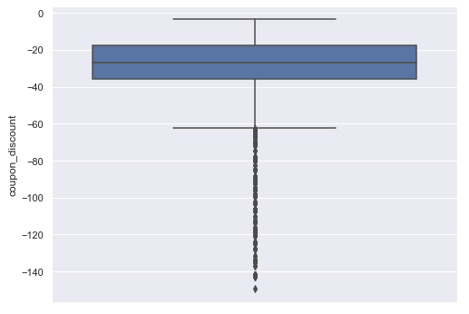
Data Analysis
Coupon discount in half the transactions falls roughly between $15 and $35
Notes:
Hypothesis: Create a Hypothesis with an emphasis on SMART principles. (S – Specific, M – Measurable, A – Achievable, R – Realistic, T – Timebound). If you cannot do this, you do not have a good grasp on the business problem.
Context: With context, we have clearly identified the problem at hand and have elucidated on how our initiative may solve this problem, alongside the commercial implications this will have on the business.
Criteria for Success: Clearly defining the criteria for success ensures that the scope of your work is clearly defined and understood. Otherwise, if this isn’t defined – your work will never end which will result in mismatched expectations.
Scope of Solution Space: Scoping out the solution space ensures that the business initiative is SPECIFIC for a certain segment or area. This prevents solutions that have been developed being scaled and applied for all other business units that the solution may not be responsible or scalable for.
Constraints within Solution Space: Looking forward, what are the foreseeable problems we are likely to encounter? Could this be stakeholder resistance? Could this be we don’t have access to the right data?
Stakeholders to provide key insight: Who are the people I need to speak to, to get the answers I need for my data analysis?
What key data sources are required?
Based off my discussions with the key stakeholders – can we clearly list out all the data sources we need so we can make a highly targeted request as opposed to a scatter-gun approach where we ask for a bit of everything?

Slide 7
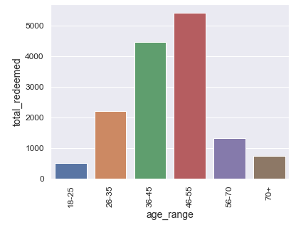
Data Analysis
People between 36 and 55 years of age redeemed most coupons
Notes:
Hypothesis: Create a Hypothesis with an emphasis on SMART principles. (S – Specific, M – Measurable, A – Achievable, R – Realistic, T – Timebound). If you cannot do this, you do not have a good grasp on the business problem.
Context: With context, we have clearly identified the problem at hand and have elucidated on how our initiative may solve this problem, alongside the commercial implications this will have on the business.
Criteria for Success: Clearly defining the criteria for success ensures that the scope of your work is clearly defined and understood. Otherwise, if this isn’t defined – your work will never end which will result in mismatched expectations.
Scope of Solution Space: Scoping out the solution space ensures that the business initiative is SPECIFIC for a certain segment or area. This prevents solutions that have been developed being scaled and applied for all other business units that the solution may not be responsible or scalable for.
Constraints within Solution Space: Looking forward, what are the foreseeable problems we are likely to encounter? Could this be stakeholder resistance? Could this be we don’t have access to the right data?
Stakeholders to provide key insight: Who are the people I need to speak to, to get the answers I need for my data analysis?
What key data sources are required?
Based off my discussions with the key stakeholders – can we clearly list out all the data sources we need so we can make a highly targeted request as opposed to a scatter-gun approach where we ask for a bit of everything?

Slide 8
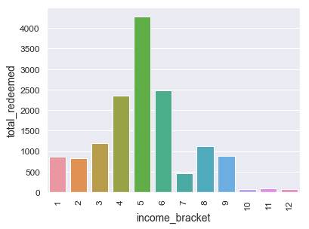
Data Analysis
People in income bracket 5 redeemed most coupons
Notes:
Hypothesis: Create a Hypothesis with an emphasis on SMART principles. (S – Specific, M – Measurable, A – Achievable, R – Realistic, T – Timebound). If you cannot do this, you do not have a good grasp on the business problem.
Context: With context, we have clearly identified the problem at hand and have elucidated on how our initiative may solve this problem, alongside the commercial implications this will have on the business.
Criteria for Success: Clearly defining the criteria for success ensures that the scope of your work is clearly defined and understood. Otherwise, if this isn’t defined – your work will never end which will result in mismatched expectations.
Scope of Solution Space: Scoping out the solution space ensures that the business initiative is SPECIFIC for a certain segment or area. This prevents solutions that have been developed being scaled and applied for all other business units that the solution may not be responsible or scalable for.
Constraints within Solution Space: Looking forward, what are the foreseeable problems we are likely to encounter? Could this be stakeholder resistance? Could this be we don’t have access to the right data?
Stakeholders to provide key insight: Who are the people I need to speak to, to get the answers I need for my data analysis?
What key data sources are required?
Based off my discussions with the key stakeholders – can we clearly list out all the data sources we need so we can make a highly targeted request as opposed to a scatter-gun approach where we ask for a bit of everything?

Slide 9
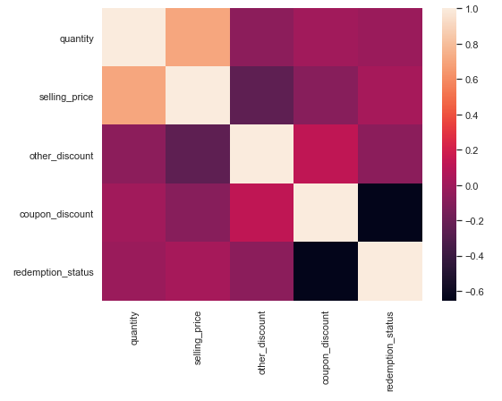
Data Analysis
Coupon discount -- Redemption status - Moderate
Selling price -- Coupon discount – Weak
Other discount -- Coupon discount - Weak
Notes:
Hypothesis: Create a Hypothesis with an emphasis on SMART principles. (S – Specific, M – Measurable, A – Achievable, R – Realistic, T – Timebound). If you cannot do this, you do not have a good grasp on the business problem.
Context: With context, we have clearly identified the problem at hand and have elucidated on how our initiative may solve this problem, alongside the commercial implications this will have on the business.
Criteria for Success: Clearly defining the criteria for success ensures that the scope of your work is clearly defined and understood. Otherwise, if this isn’t defined – your work will never end which will result in mismatched expectations.
Scope of Solution Space: Scoping out the solution space ensures that the business initiative is SPECIFIC for a certain segment or area. This prevents solutions that have been developed being scaled and applied for all other business units that the solution may not be responsible or scalable for.
Constraints within Solution Space: Looking forward, what are the foreseeable problems we are likely to encounter? Could this be stakeholder resistance? Could this be we don’t have access to the right data?
Stakeholders to provide key insight: Who are the people I need to speak to, to get the answers I need for my data analysis?
What key data sources are required?
Based off my discussions with the key stakeholders – can we clearly list out all the data sources we need so we can make a highly targeted request as opposed to a scatter-gun approach where we ask for a bit of everything?

Slide 10
Modeling
Algorithms compared – Random Forest, Logistic Regression, XG Boost
Metric for scoring – Area under ROC curve
Algorithm chosen – XG Boost Classifier
Notes:
Hypothesis: Create a Hypothesis with an emphasis on SMART principles. (S – Specific, M – Measurable, A – Achievable, R – Realistic, T – Timebound). If you cannot do this, you do not have a good grasp on the business problem.
Context: With context, we have clearly identified the problem at hand and have elucidated on how our initiative may solve this problem, alongside the commercial implications this will have on the business.
Criteria for Success: Clearly defining the criteria for success ensures that the scope of your work is clearly defined and understood. Otherwise, if this isn’t defined – your work will never end which will result in mismatched expectations.
Scope of Solution Space: Scoping out the solution space ensures that the business initiative is SPECIFIC for a certain segment or area. This prevents solutions that have been developed being scaled and applied for all other business units that the solution may not be responsible or scalable for.
Constraints within Solution Space: Looking forward, what are the foreseeable problems we are likely to encounter? Could this be stakeholder resistance? Could this be we don’t have access to the right data?
Stakeholders to provide key insight: Who are the people I need to speak to, to get the answers I need for my data analysis?
What key data sources are required?
Based off my discussions with the key stakeholders – can we clearly list out all the data sources we need so we can make a highly targeted request as opposed to a scatter-gun approach where we ask for a bit of everything?

Slide 11
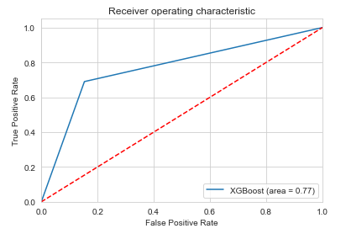
Modeling
Final score (area under roc curve): 0.77
Notes:
Hypothesis: Create a Hypothesis with an emphasis on SMART principles. (S – Specific, M – Measurable, A – Achievable, R – Realistic, T – Timebound). If you cannot do this, you do not have a good grasp on the business problem.
Context: With context, we have clearly identified the problem at hand and have elucidated on how our initiative may solve this problem, alongside the commercial implications this will have on the business.
Criteria for Success: Clearly defining the criteria for success ensures that the scope of your work is clearly defined and understood. Otherwise, if this isn’t defined – your work will never end which will result in mismatched expectations.
Scope of Solution Space: Scoping out the solution space ensures that the business initiative is SPECIFIC for a certain segment or area. This prevents solutions that have been developed being scaled and applied for all other business units that the solution may not be responsible or scalable for.
Constraints within Solution Space: Looking forward, what are the foreseeable problems we are likely to encounter? Could this be stakeholder resistance? Could this be we don’t have access to the right data?
Stakeholders to provide key insight: Who are the people I need to speak to, to get the answers I need for my data analysis?
What key data sources are required?
Based off my discussions with the key stakeholders – can we clearly list out all the data sources we need so we can make a highly targeted request as opposed to a scatter-gun approach where we ask for a bit of everything?

Slide 12
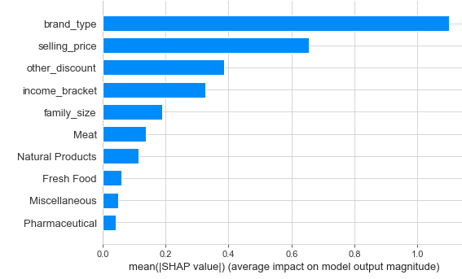
Most Important Features for Coupon Redemption
Notes:
Hypothesis: Create a Hypothesis with an emphasis on SMART principles. (S – Specific, M – Measurable, A – Achievable, R – Realistic, T – Timebound). If you cannot do this, you do not have a good grasp on the business problem.
Context: With context, we have clearly identified the problem at hand and have elucidated on how our initiative may solve this problem, alongside the commercial implications this will have on the business.
Criteria for Success: Clearly defining the criteria for success ensures that the scope of your work is clearly defined and understood. Otherwise, if this isn’t defined – your work will never end which will result in mismatched expectations.
Scope of Solution Space: Scoping out the solution space ensures that the business initiative is SPECIFIC for a certain segment or area. This prevents solutions that have been developed being scaled and applied for all other business units that the solution may not be responsible or scalable for.
Constraints within Solution Space: Looking forward, what are the foreseeable problems we are likely to encounter? Could this be stakeholder resistance? Could this be we don’t have access to the right data?
Stakeholders to provide key insight: Who are the people I need to speak to, to get the answers I need for my data analysis?
What key data sources are required?
Based off my discussions with the key stakeholders – can we clearly list out all the data sources we need so we can make a highly targeted request as opposed to a scatter-gun approach where we ask for a bit of everything?

Slide 13
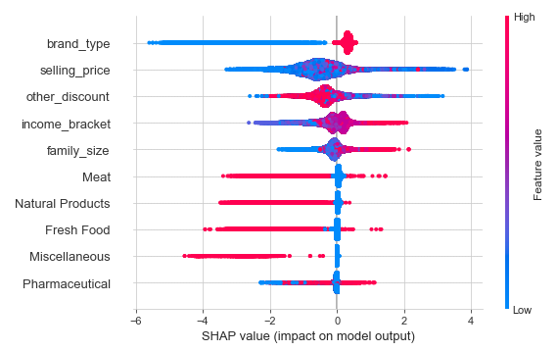
Most Important Features for Coupon Redemption
Brand Type – increases for established brands
Selling Price - most occurrences in mid-price range
Other Discount - increases for lower other discounts
Notes:
Hypothesis: Create a Hypothesis with an emphasis on SMART principles. (S – Specific, M – Measurable, A – Achievable, R – Realistic, T – Timebound). If you cannot do this, you do not have a good grasp on the business problem.
Context: With context, we have clearly identified the problem at hand and have elucidated on how our initiative may solve this problem, alongside the commercial implications this will have on the business.
Criteria for Success: Clearly defining the criteria for success ensures that the scope of your work is clearly defined and understood. Otherwise, if this isn’t defined – your work will never end which will result in mismatched expectations.
Scope of Solution Space: Scoping out the solution space ensures that the business initiative is SPECIFIC for a certain segment or area. This prevents solutions that have been developed being scaled and applied for all other business units that the solution may not be responsible or scalable for.
Constraints within Solution Space: Looking forward, what are the foreseeable problems we are likely to encounter? Could this be stakeholder resistance? Could this be we don’t have access to the right data?
Stakeholders to provide key insight: Who are the people I need to speak to, to get the answers I need for my data analysis?
What key data sources are required?
Based off my discussions with the key stakeholders – can we clearly list out all the data sources we need so we can make a highly targeted request as opposed to a scatter-gun approach where we ask for a bit of everything?

Slide 14
Looking Forward – Improving the Model
Extracting relevant transactions
Adding more customer features
Time series analysis
Notes:
Hypothesis: Create a Hypothesis with an emphasis on SMART principles. (S – Specific, M – Measurable, A – Achievable, R – Realistic, T – Timebound). If you cannot do this, you do not have a good grasp on the business problem.
Context: With context, we have clearly identified the problem at hand and have elucidated on how our initiative may solve this problem, alongside the commercial implications this will have on the business.
Criteria for Success: Clearly defining the criteria for success ensures that the scope of your work is clearly defined and understood. Otherwise, if this isn’t defined – your work will never end which will result in mismatched expectations.
Scope of Solution Space: Scoping out the solution space ensures that the business initiative is SPECIFIC for a certain segment or area. This prevents solutions that have been developed being scaled and applied for all other business units that the solution may not be responsible or scalable for.
Constraints within Solution Space: Looking forward, what are the foreseeable problems we are likely to encounter? Could this be stakeholder resistance? Could this be we don’t have access to the right data?
Stakeholders to provide key insight: Who are the people I need to speak to, to get the answers I need for my data analysis?
What key data sources are required?
Based off my discussions with the key stakeholders – can we clearly list out all the data sources we need so we can make a highly targeted request as opposed to a scatter-gun approach where we ask for a bit of everything?

